Slide 1
Machine Learning techniques for automatic ocular artifact correction in resting state EEG Practices and recommendations for the CHDR
Lisa Tostrams, BSc (Radboud University)
Supervisors: Dr. J.D.R Farquhar (Radboud University) Dr. Y.M. Mejia (CHDR) Dr.ir. R.J. Doll (CHDR)

Slide 2
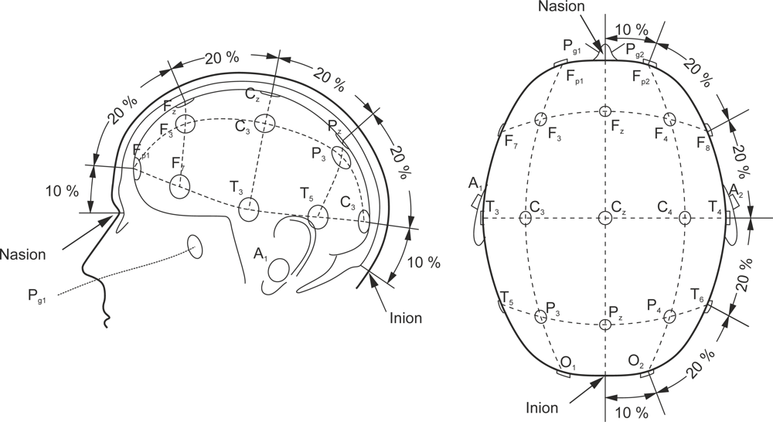
Electroencephalography
One of the methods used by CHDR to assess the effect of a drug
Quantification of resting state EEG
Eyes closed, eyes open
Calculate power spectrum

Slide 3
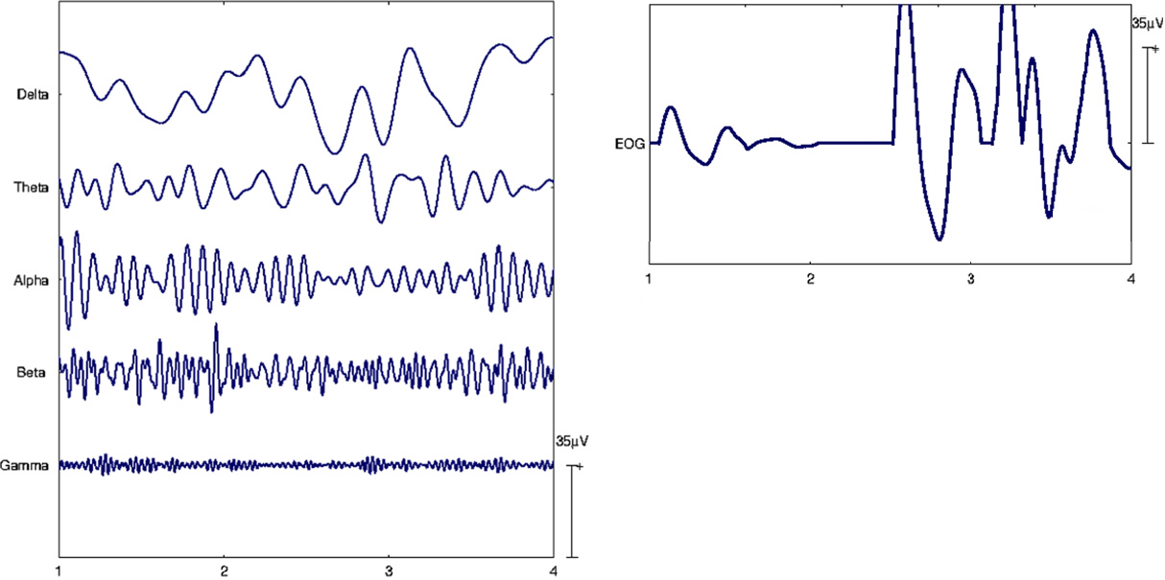
EEG and EOG
EEG often contains artefacts caused by EOG
Decreased the quality of the data and of the outcomes

Slide 4
Ocular artefact correction
Two ways to deal with artefacts:
Remove affected intervals
Correct the signal
Research internship consisted of literary review
Methods for automated EOG correction

Slide 5
Methods for ocular artefact correction
4 general classes:
Linear regression
Filtering
Blind source separation
Source decomposition
Requirements?
Automated, correction not rejection, simplicity, quality..

Slide 6
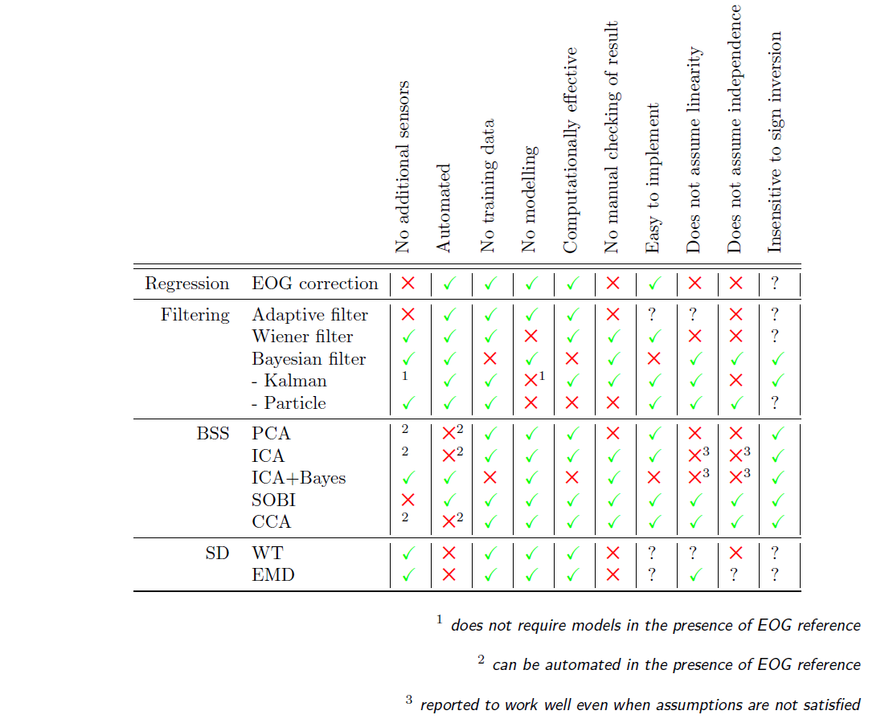
Methods and requirements
SOBI: Second order blind inference
Doesn’t require modelling, makes very few assumptions, relatively simple to implement

Slide 7
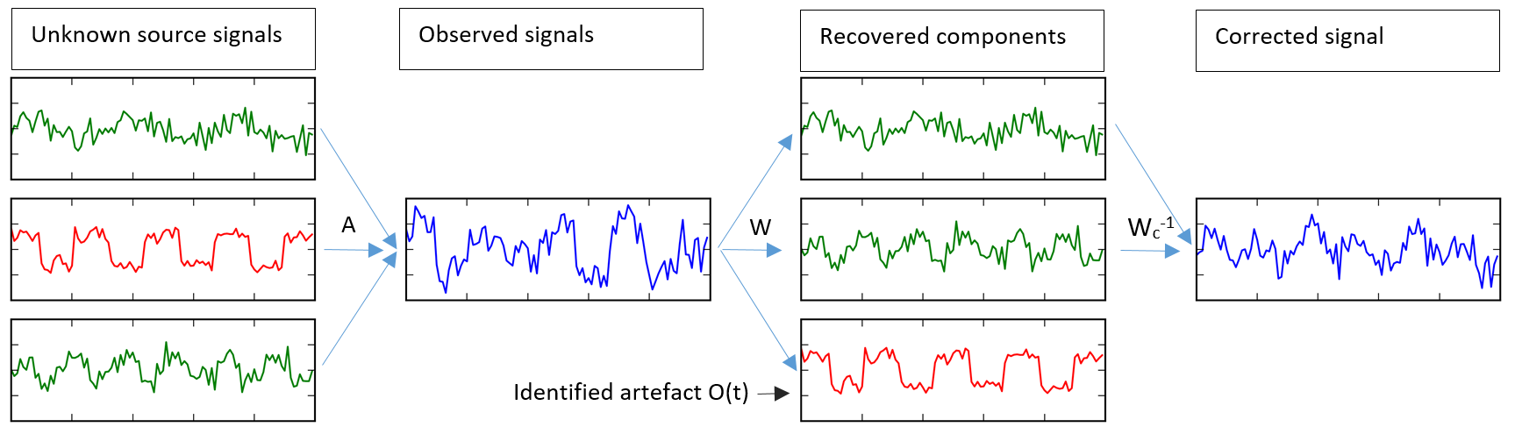
Second Order Blind Inference
Blind source seperation: recover independent sources from signals that record a linear mixture
SOBI uses decorrelation across several lags as its basic computation
Resolved synchronized activity across time lags: important for propagating signals!

Slide 8
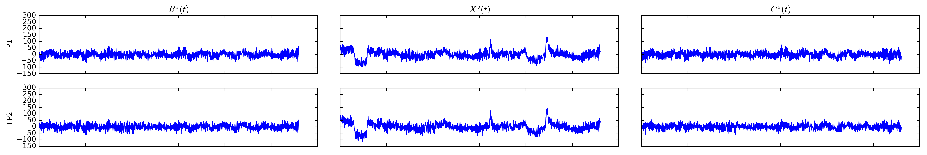
Some results on simulated data
First column: simulated ‘true’ signal
Second column: simulated signal including artefacts
Third column: Signal corrected by SOBI

Slide 9
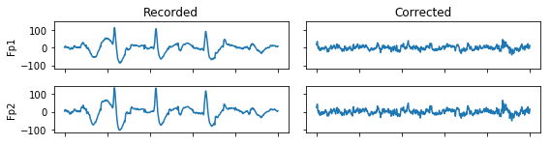
Some results on acquired data

Slide 10
How to validate?
Easy with simulated data: compare correction to true signal
Signal to Noise Ratio
Correlation increase
Normalized Mean Squared Error
Harder with acquired data: quantitative evaluation of signal intervals with ocular artefacts
Need a ground truth: signal labelled by domain expert
Calculate true positives (corrects where artefact occurs)
Calculate false positives (corrects when no artifacts occurs)

Slide 11
What’s left to do?
Optimalization
Current SOBI implementation takes a lot of time..
Due to one specific operation: joint diagonalization
Need to find a more efficient computation
Operationalization
Validation

